Slide 1

MLOps
Adrian Petrescu

Slide 2
Schedule
Day 1 – Public cloud
day 2 – Distributed Computing
Day 3 – AI/ML Lifecycle
Day 4 – ML Ops
A brief history of the cloud, and its current state
AWS platform services overview
Pricing models
Live demo
Cloud architecture
Define the AI/ML Lifecycle:
Data Processing
Feature Generation
Training
Inference
Upcoming AI use cases
Demos of VertexAI, AutoML
Overrun from the previous 3 weeks first
Kubeflow Pipelines
Some case studies of big data architectures
Programming assignment and logistics
Scaling horizontally and vertically
MapReduce, Hadoop, and the history of commercially-available distributed systems
Introducing Kubernetes
Notes:
Why are we talking about cloud in a Hadoop course?
- Because without cloud, distributed computing would be a niche topic

Slide 3
AI Use Cases
AI Is Anything You Can’t Do In Excel

Slide 4
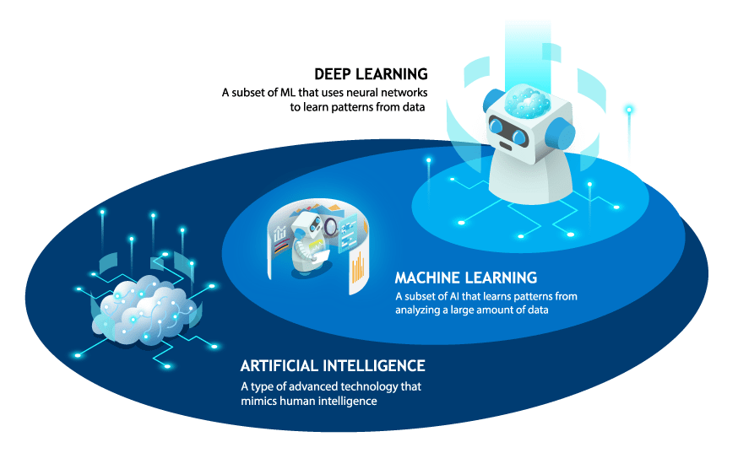
AI vs ML
Although often used interchangeably, Machine Learning is a particular subset of Artificial Intelligence; specifically the one that benefits from large volumes of labeled or unlabeled data.
Most of the excitement around AI these days is being generated by the even more specific subset of Deep Learning.

Slide 5
Machine Learning Lifecycle
Forecasts
Inference
Monitoring
Unlike traditional software systems that operate deterministically according to requirements and algorithms that are determined at development time, ML systems learn at runtime from data, and their behaviour is inherently unstable and unpredictable.
Care must be taken at every step of the lifecycle to ensure data is clean, models are accurate, etc.
Model
Datasets
Feature Bundle
Training
Data Transformation/
Feature Extraction

Slide 6
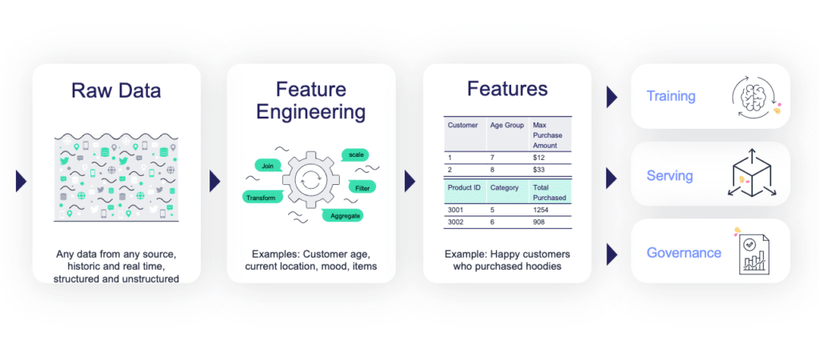
Data Transformation
This stage has a lot in common with traditional ETL pipelines, and long predates AI/ML.
Data sets for ML are often unusually large and unstructured, making them a particularly good fit for distributed algorithms.
Often accomplished with a Spark-based stack

Slide 7
Data Transformation
Key Techniques:
Cleaning: Handling missing values, outliers, and inconsistencies.
Scaling/Normalization: Ensures features have a similar range.
Feature Encoding: Converting categorical features to numeric ones.
Creation of New Features: Combining or calculating features to increase model understanding.

Slide 8
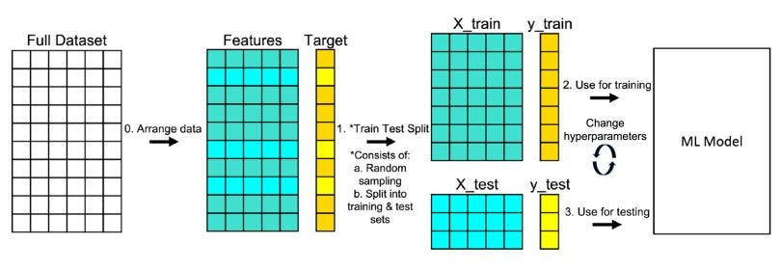
Model Training
We divide our dataset into training and testing sets. A model learns patterns from the training set, but performance on the held-out test set gives us a true assessment of how well it generalizes to unseen data.
Metrics calculated on the test set (e.g., accuracy, F1-score) tell us how good our model is, helping us decide if we're satisfied or need to make adjustments.
Before training, we often don't know the ideal settings (hyperparameters) for our model. These control the learning process itself. We might perform many training runs using different combinations of hyperparameters, comparing results on the test set.
This is actually a cyclic process–evaluation metrics guide us to try again with different model specifications or hyperparameters. The goal is to find the combination leading to the best possible performance on the test set

Slide 9
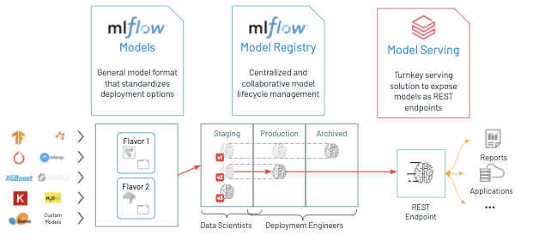
Model Serving
At the end of the day, a model is just a bunch of weights – i.e, a block of numbers in a file.
It’s up to some sort of routine to load these numbers into an architecture that can use them to make predictions; this stage is often called “inference”
Deployment options can vary:
REST APIs: A common way to interact with models – apps send data, get a prediction in response.
Batch-mode Inference: Predicting on larger datasets less frequently, perhaps on a schedule.
Edge Deployment: Placing models on specialized devices directly where data is generated (e.g., self-driving car models).
No matter which deployment option you’re in, you almost certainly want to have some way to continuously monitor the quality of the generated inferences.

Slide 10
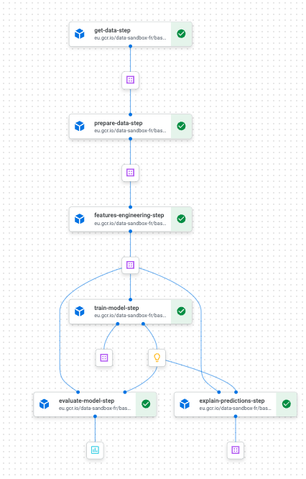
ML Pipelines
Every stage in an ML pipeline produces some sort of artifact, whether that artifact is data/metadata, a model, a forecast, etc.
Ideally, these artifacts should have some combination of the following properties:
Immutable: An artifact cannot be modified once it has been written. This requires careful namespacing to prevent conflicts.
Reproducible: To the extent possible, artifacts should be a pure function of their inputs.
Durable: Artifacts, and the metadata which produced them, should remain available for as long as any dependent/dependency continues to exist.

Slide 11
Vertex Ai
Hopefully Google doesn’t get bored of this one anytime soon

Slide 12
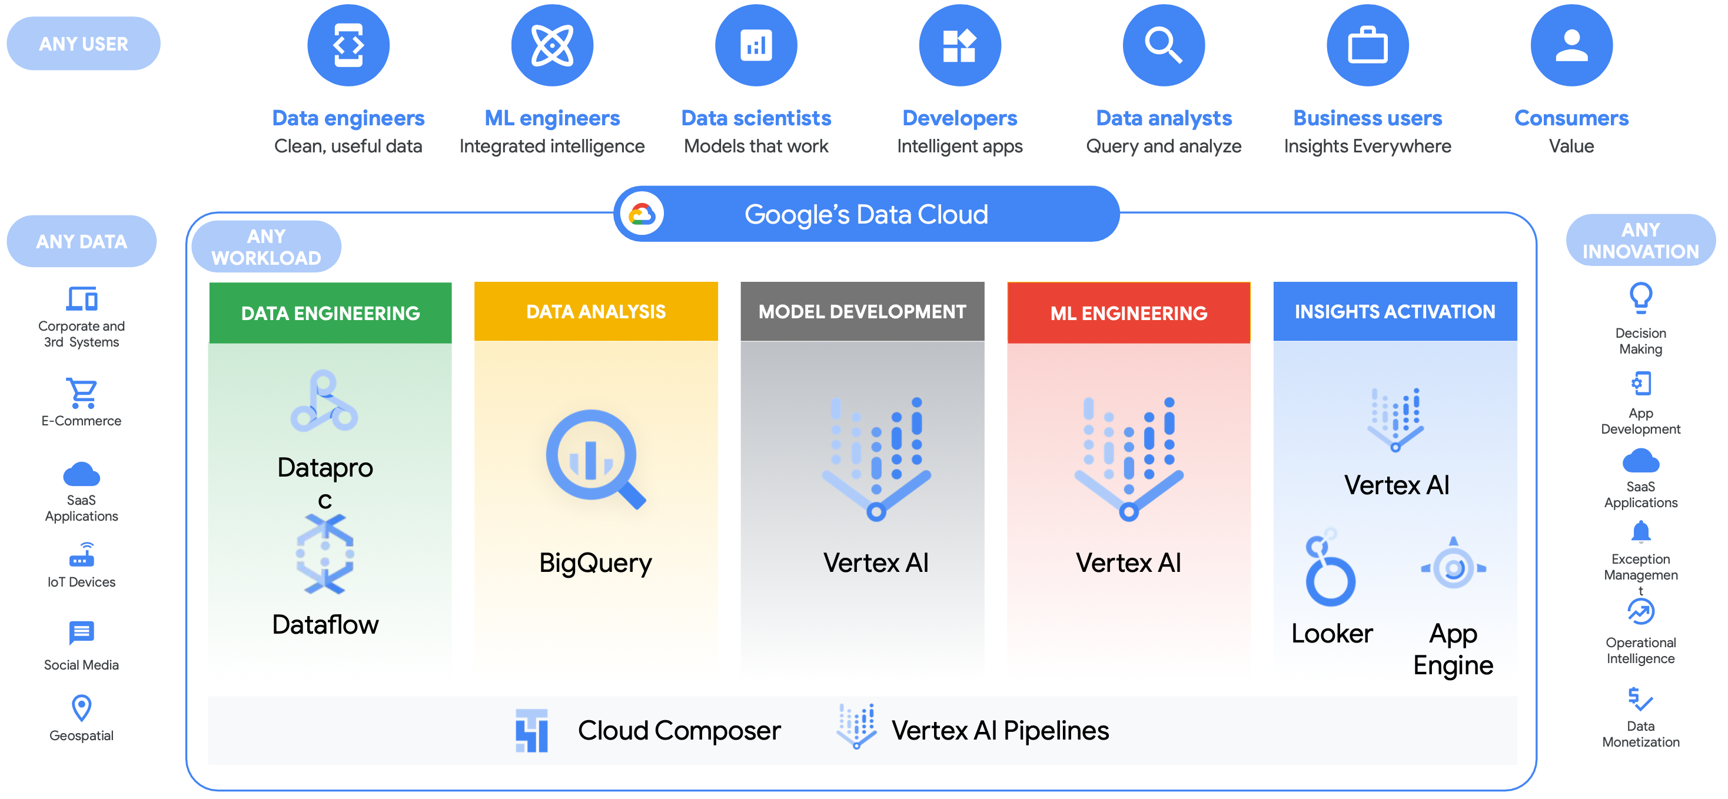
What is Vertex AI?
Vertex AI is simply an umbrella marketing term for a variety of independent Data/AI-focused GCP services, some new and some old.
The term “Vertex” doesn’t actually appear in any of the Google Cloud APIs, SDK commands, or Terraform modules, except in docstrings!
The goal is clearly to unify and highlight synergies between GCP services on the entire “Data⇒Value” journey, to incentivize developers away from more easily-portable “Kubeflow-on-GKE” designs.

Slide 13





Machine Learning Lifecycle
Inference
Monitoring
Unlike traditional software systems that operate deterministically according to requirements and algorithms that are determined
Training
Feature Extraction

